Slide 1
Individual Homework
Chereji Iulia Maria, group 912

Slide 2
Exercise 2.2-Resolution in propositional logic
Consider the following hypotheses:
H1: Mary will go to London this summer if and only if both her friends Kate and Susan go.
H2: If Kate passes the English exam in May then she will go to London.
H3: Kate was in hospital from April until July and she didn’t take the English exam.
H4: This summer Susan will go to London on a business trip.
and the conclusion C: Mary will go to London this summer.
Try to simplify the initial set of clauses by applying the transformations based on Davis-Putman procedure. Using the set-of-support strategy in propositional resolution check whether the following deduction holds: .

Slide 3
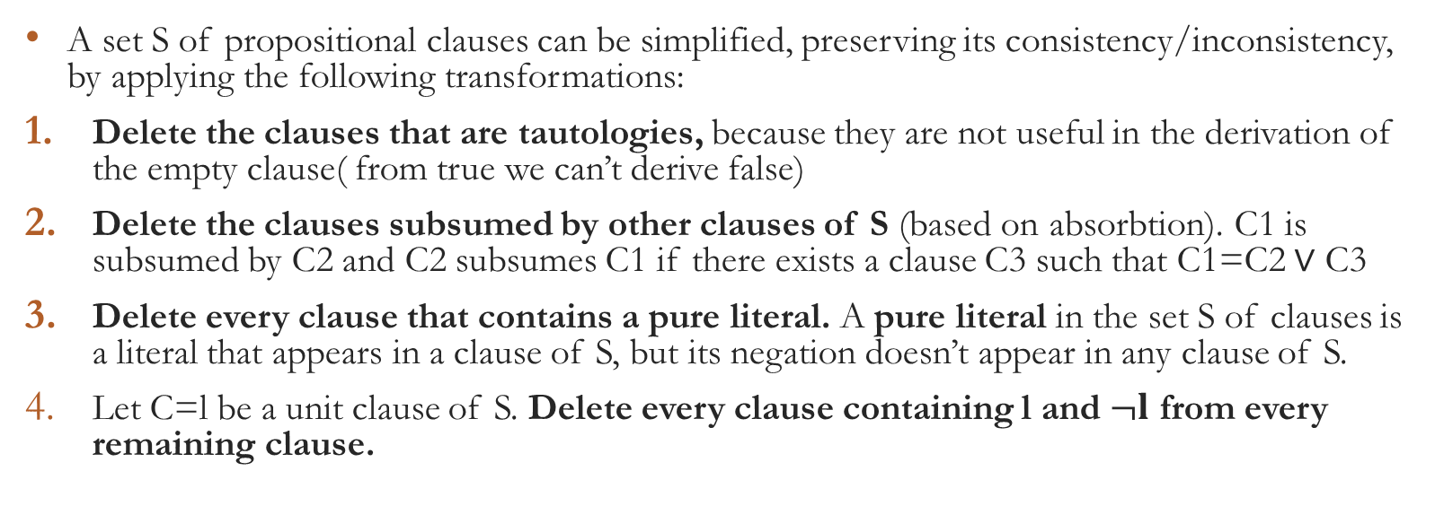
Theoretical results-Davis Putman procedure
A set S of propositional clauses can be simplified, preserving its consistency/inconsistency, by applying the following transformations:
Delete the clauses that are tautologies, because they are not useful in the derivation of the empty clause( from true we can’t derive false)
Delete the clauses subsumed by other clauses of S (based on absorbtion). C1 is subsumed by C2 and C2 subsumes C1 if there exists a clause C3 such that C1=C2 $∨$ C3
Delete every clause that contains a pure literal. A pure literal in the set S of clauses is a literal that appears in a clause of S, but its negation doesn’t appear in any clause of S.
Let C=l be a unit clause of S. Delete every clause containing l and $¬l$ from every remaining clause.

Slide 4
Theoretical results – strategies of resolution
The set-of-support strategy avoids resolving 2 clauses belonging to a consistent subset of the initial set of clauses because the resolvents derived from a consistent set are irrelevant in the process of deriving □ (inconsistency)
Definition: Let S be a set of clauses. A subset Y of S is called the support set of S if the set S\Y is consistent. The set-of-support resolution is the resolution of 2 clauses that are not both from the set S\Y. The resolvents generated during the resolution process are added to Y.

Slide 5
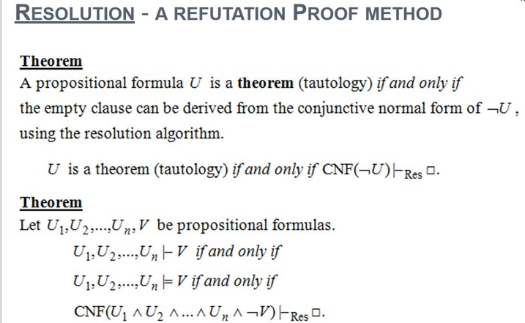
Theoretical result

Slide 6
Consider the following hypotheses:
H1: Mary will go to London this summer if and only if both her friends Kate and Susan go.
H2: If Kate passes the English exam in May then she will go to London.
H3: Kate was in hospital from April until July and she didn’t take the English exam.
H4: This summer Susan will go to London on a business trip.
and the conclusion C: Mary will go to London this summer.
We denote the propositional variables by:
M – Mary will go to London
K – Kate will go to London.
S – Susan will go to London
KE – Kate passed her English exam.
KH – Kate was in hospital
Then:
H1: K ∧𝑆↔𝑀
H2: 𝐾𝐸→𝐾
H3:KH ∧ ┐𝐾𝐸
H4: S
C: M

Slide 7

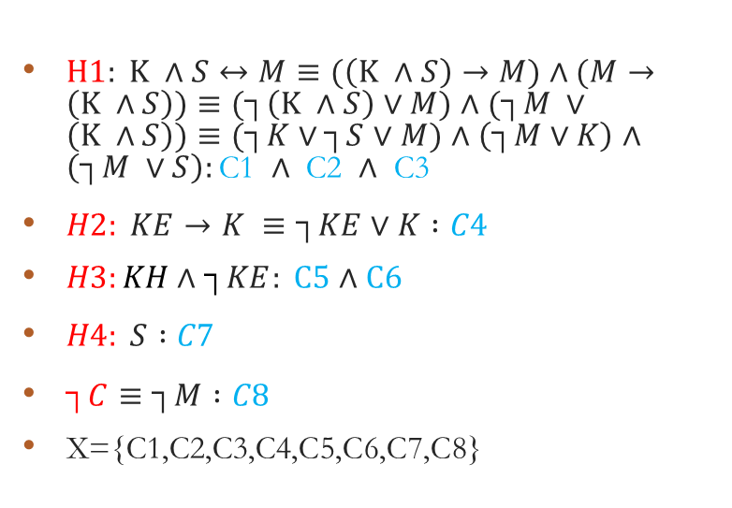
Modeling reasoning
H1: Mary will go to London this summer if and only if both her friends Kate and Susan go.
H2: If Kate passes the English exam in May then she will go to London.
H3: Kate was in hospital from April until July and she didn’t take the English exam.
H4: This summer Susan will go to London on a business trip.
and the conclusion C: Mary will go to London this summer.
$H1: K ∧S↔M≡(\left(K ∧S\right)→M)∧(M→\left(K ∧S\right))≡(┐\left(K ∧S\right)$ $∨M)∧(┐M ∨\left(K ∧S\right))≡(┐K∨┐S$ $∨M)$ $∧\left(┐M∨K\right)∧\left(┐M ∨S\right):\text{C}\text{1 }∧ \text{C}\text{2 }∧ \text{C}\text{3}$
$H2: KE→K ≡┐KE∨K :C4$
$H3:KH \text{∧} ┐KE: C5 \text{∧}$ $C6$
$H4: S :C7$
$┐C≡┐M :C8$
X={C1,C2,C3,C4,C5,C6,C7,C8}

Slide 8
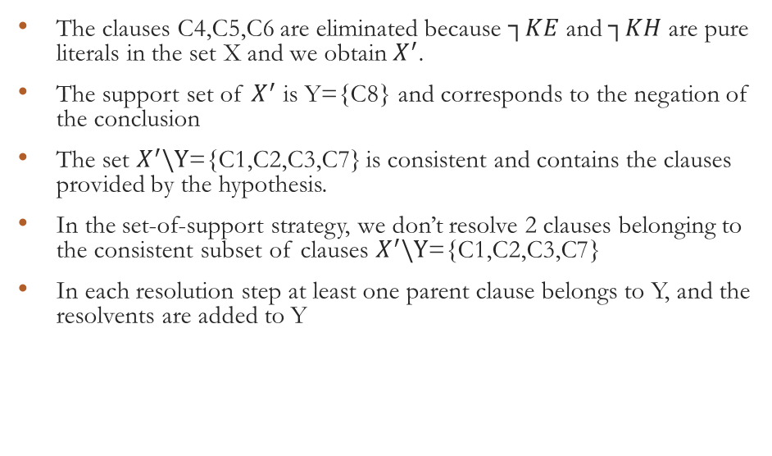

The set-of-support strategy
X={C1,C2,C3,C4,C5,C6,C7}
C1: $((┐K∨┐S$) $∨M$)
C2: $\left(┐M∨K\right)$
C3: $\left(┐M ∨S\right)$
C4: $┐KE∨K$
C5 $:┐KH$
C7: $S$
C6 $:┐KE$
C8: $┐M$
$X^{′}$={C1 ,C2, C3, C7, C8}
The clauses C4,C5,C6 are eliminated because $┐KE$and $┐KH$are pure literals in the set X and we obtain $X^{′}$.
The support set of $X^{′}$ is Y={C8} and corresponds to the negation of the conclusion
The set $X^{′}\backslash Y$={C1,C2,C3,C7} is consistent and contains the clauses provided by the hypothesis.
In the set-of-support strategy, we don’t resolve 2 clauses belonging to the consistent subset of clauses $X^{′}\backslash Y$={C1,C2,C3,C7}
In each resolution step at least one parent clause belongs to Y, and the resolvents are added to Y

Slide 9

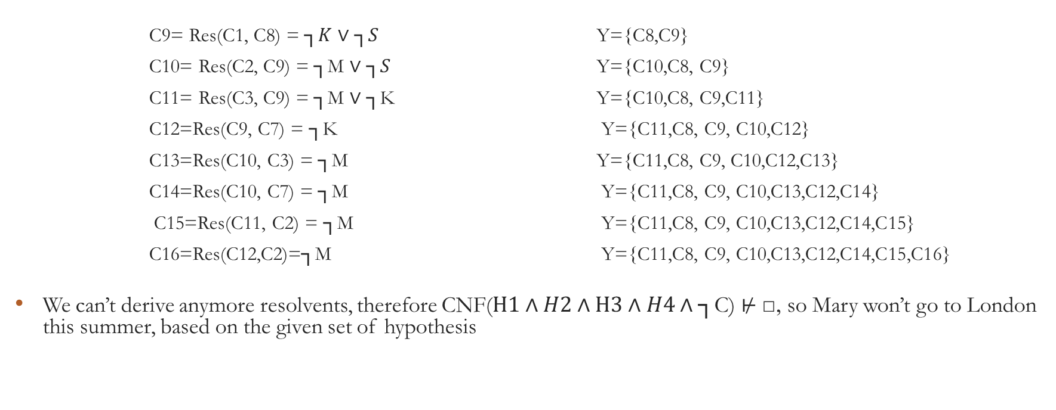
The set-of-support strategy
C1: $(┐K∨┐S$ $∨M$)
C2: $\left(┐M∨K\right)$
C3: $\left(┐M ∨S\right)$
C7: S
C8: $┐M$
C9= Res(C1, C8) = ┐𝐾 ∨ ┐𝑆 Y={C8,C9}
C10= Res(C2, C9) = ┐M ∨ ┐𝑆 Y={C10,C8, C9}
C11= Res(C3, C9) = ┐M ∨ ┐K Y={C10,C8, C9,C11}
C12=Res(C9, C7) = ┐K Y={C11,C8, C9, C10,C12}
C13=Res(C10, C3) = ┐M Y={C11,C8, C9, C10,C12,C13}
C14=Res(C10, C7) = ┐M Y={C11,C8, C9, C10,C13,C12,C14}
C15=Res(C11, C2) = ┐M Y={C11,C8, C9, C10,C13,C12,C14,C15}
C16=Res(C12,C2)=┐M Y={C11,C8, C9, C10,C13,C12,C14,C15,C16}
We can’t derive anymore resolvents, therefore CNF($H1∧H2∧H3∧H4∧\text{┐}\text{C}\text{)}⊬$ □, so Mary won’t go to London this summer, based on the given set of hypothesis

